Slide 1

Identify Chennai Neighborhoods for opening ‘Hang-out themed Snack bar’
Parthi Kumar S

Slide 2
Introduction/Business problem
In this project , the objective is to try to find a set of hot-spot locations for a hang-out themed Snack bar. This report will be targeted to those stakeholders who are interested in opening a chain of ‘Hang-out themed Snack bar’ in ‘Chennai, India’.
The definition of 'Hang-out themed Snack Bar' here is a place where people unwind in the evening/weekends or after a long day at work/schools/colleges for tasty snacks/foods(light evening foods) and fun time with their friends/family. The place is designed as an alternative to cater to the same crowd who visits any of these following venues- cafe bar, Coffee Bar, Snack Bar, Dessert Bar, Juice bar, Ice-cream Parlor, Pizza Bar, Fast Food Center, Sandwich Shop, Bakery, Chaat Corner, Food Truck, Tea Stall. We will try to detect locations that have demand for such hang-out places in the Chennai City . The rationale behind is to come up with a list of potential locations where there are already venues which provides similar experiences through the above-mentioned venues and know there is a demand(audience) for these hang-out themed Snack bars . This way these new hang-out themed snack bars could provide as a viable alternative catering to these segments highlighting the wholesome experience it brings along with it.
Using FourSquare APIs , the list of hot-spot tier-1 locations(with high demand for these hang-out bars) and the next-best tier-2(Moderate demand) locations across Chennai. Focus is to first identify the hot-regions(borroughs with high demand for these venues) in Chennai for setting up a chain of these hang-out themed snack bars and then provide the neighborhood clusters in them to make informed decision . In real-time scenario, some more deep-dive analysis needs to be done by considering real-estate prices, rent prices, transport and the landmarks nearby(offices/schools/colleges)- hence as part of this project we would effectively narrow down high-demand pocket areas within Chennai in which potentially a chain of hang-out themed snack bars could be opened .

Slide 3
Data
Based on definition of our problem, critical factor that will influence the decision is:
* number of existing venues as mentioned in this list(cafe bar, Coffee Bar,Snack Bar,Dessert Bar,Juice bar,Ice-cream Parlor ,Pizza Bar,Fast Food Center, Sandwich Shop, Bakery, Chaat Corner, Food Truck,Tea Stall) in the neighborhood and corresponding region(boroughs)
Following data sources will be needed to extract/generate the required information:
* geospatial coordinates of the Chennai Neighborhood along with the regions from this wiki page - Following data sources will be needed to extract/generate the required information : https://en.wikipedia.org/wiki/List_of_neighbourhoods_of_Chennai
* number of restaurants and their type and location in every neighborhood will be obtained using Foursquare API

Slide 4
Methodology
In this project - the high-demand areas for 'hangout-themed snack bars' in Chennai are to be identified.
In first step , the required data: from the wiki page https://en.wikipedia.org/wiki/List_of_neighbourhoods_of_Chennai are collected and then using FourSquare API identified data: Count of Venues such as 'cafe bar, Coffee Bar, Snack Bar, Dessert Bar, Juice bar, Ice-cream Parlor, Pizza Bar, Fast Food Center, Sandwich Shop, Bakery, Chaat Corner, Food Truck, Tea Stall' across different neighborhoods pertaining to different regions(boroughs) of Chennai (these venues are categorized according to Foursquare categorization).
Second step in the analysis is to find the high demand for these kind of hang-out places in regions(boroughs) of Chennai to focus on the neighborhoods only from these regions. For this , group by(regions) and get the total sum of these hangout venues from the results of Foursquare data. Based on the total values, the 'high-demand' regions are identified for further analysis.

Slide 5
Methodology
In the third and final in the analysis is to find the most happening neighborhood clusters among these 'high-demand' regions .
The primary objective for neighborhood clusters is to establish a chain of these new 'hang-out themed Snack bars' in those clusters based on the target audience and demand for such hangout places.
For this,get the present map of these identified 'high-demand' regions and also create clusters (using k-means clustering with cluster size 5) within these regions(boroughs) of chennai. Each 'high-demand' region will have 5 neighborhood clusters based on the 'total_hangout' value as the base parameter for clustering.
Total_hangout' of a neighborhood is the total sum of all the counts of these venues(cafe bar,Coffee Bar,Snack Bar,Dessert Bar,Juice bar,Ice-cream Parlour,Pizza Bar,Fast Food Center,Sandwich Shop,Bakery,Chaat Corner,Food Truck,Tea Stall).
From them, the most-happening 'neighborhood clusters' are identified across these 'high-demand' regions. Then the final list of 'Tier-1' hotspot locations are identified from these 'neighborhood clusters' based on a certain threshold value and also next-best'tier-2' location are identified based on the next-best available threshold value. these will be shared with Stakeholders to do further deep-dive into these 'tier-1' and 'tier-2' locations by considering real-estate prices,rent prices, transport and the landmarks nearby(offices/schools/colleges) to make an informed decision

Slide 6
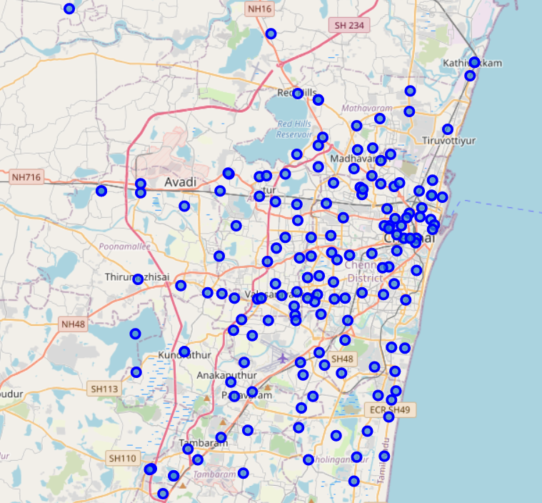
Analysis
Chennai with all the neighborhoods as markers

Slide 7
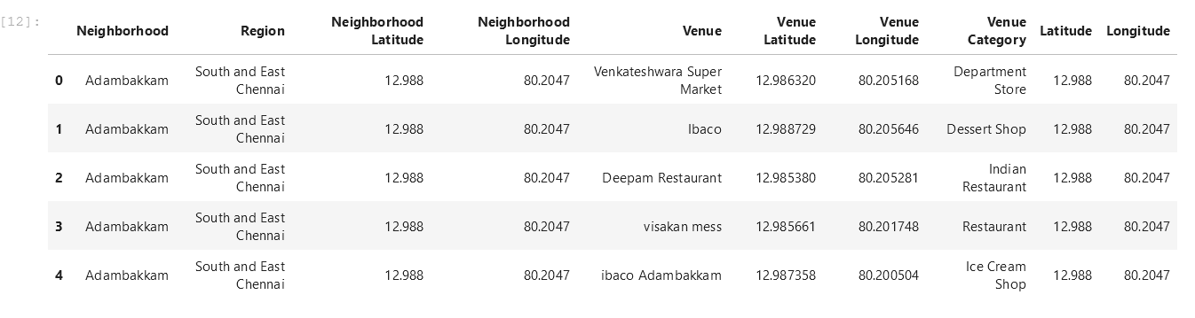
Analysis
Details obtained from FourSquare API for the Chennai Neighborhoods with all the venue details

Slide 8
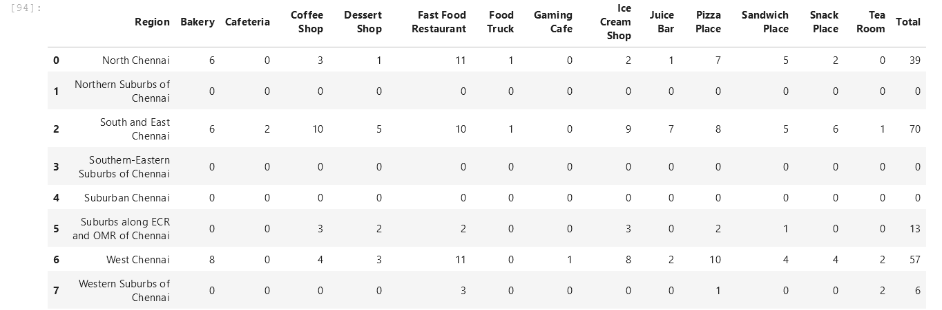
Analysis
After filtering the venues catering to the snack segment, total of such venues is identified per region . Regions with ‘high-demand’ for such venues are obtained from this – North, South-East, West regions using the ‘total’ parameter(Sum of all the venue counts)

Slide 9
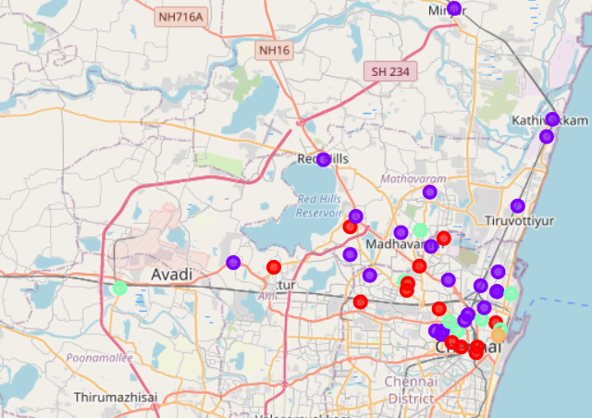
Analysis
Cluster Map for North Region in Chennai

Slide 10
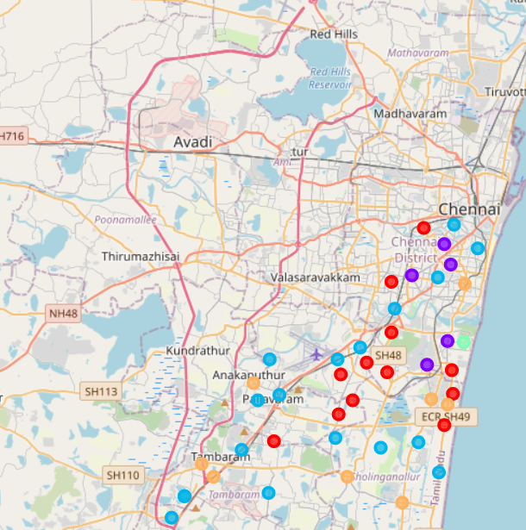
Analysis
Cluster Map for South-East Region in Chennai

Slide 11
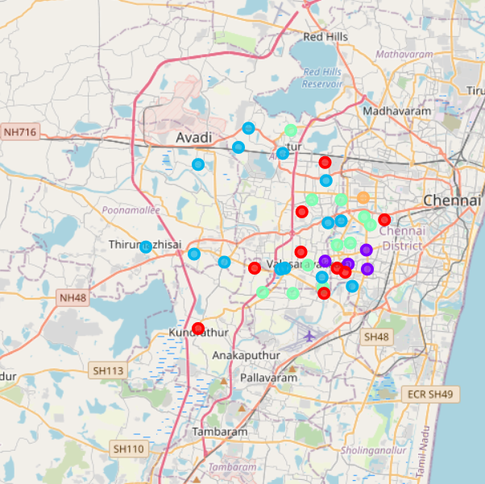
Analysis
Cluster Map for West Region in Chennai

Slide 12
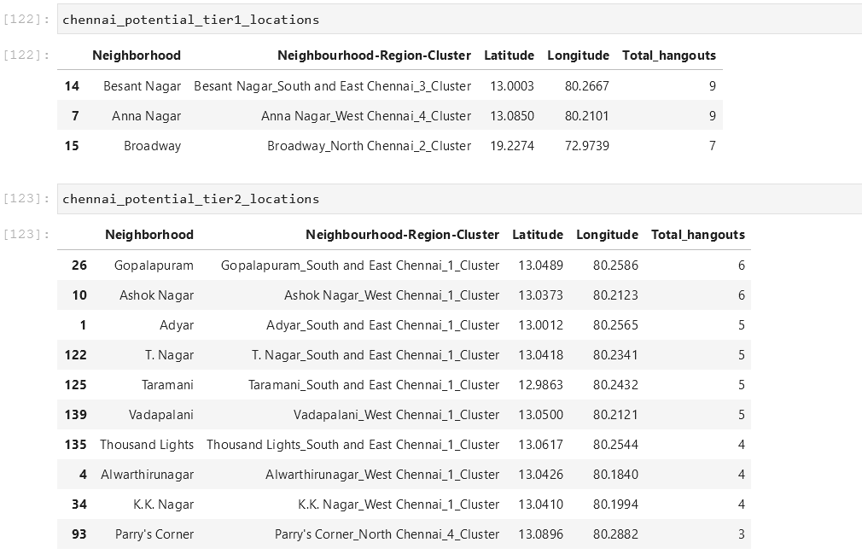
Analysis
Base on the cluster data available across these 3 regions , Neighborhood clusters are identified. And then it is split into tier-1 and tier-2 locations

Slide 13
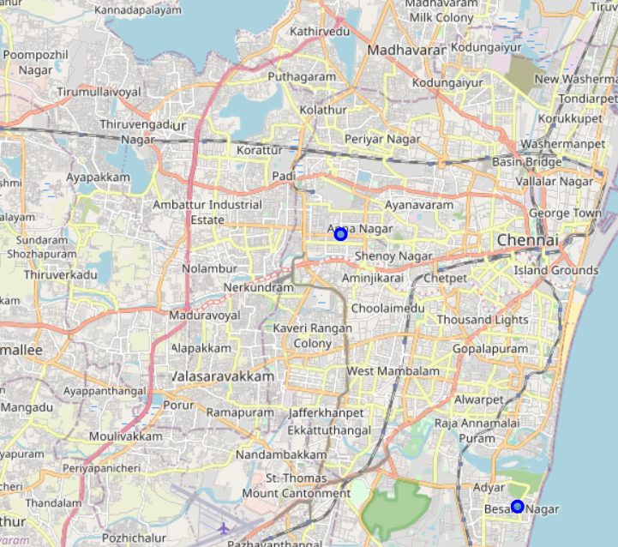
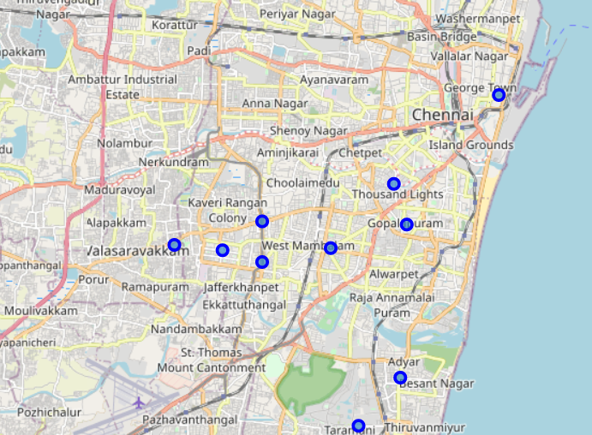
Analysis
Tier-1 and Tier2 location maps.
Tier1- has 3 points
Tier2 – has 10 points

Slide 14
Result and Discussion
Analysis shows that the 3 hot-spot regions are - North, South-East and West regions of Chennai. These are based on the 'Total-hangouts' count when it is grouped under 'Regions'.
Once the regions are identified, each region is divided into 5 clusters. There will be 15 clusters in total.Among these 15 clusters, most-happening neighborhood clusters are identified. Most happening clusters are (chennai_north_cluster2, chennai_north_cluster4, chennai_west_cluster1, chennai_west_cluster4, chennai_south_east_cluster1,chennai_south_east_cluster3). The neighborhood-clusters are identified based on the 'Total-hangouts’.
Tier-1 locations and Tier-2 locations are split based on the threshold value (7).
Tier1 location: Besant Nagar, Anna Nagar, Broadway
Tier 2 location : Gopalapuram , Ashok Nagar , Adyar, T.Nagar, Taramani, Vadapalani , Thousandlights, Alwarthirunagar, K.K.Nagar, Parry'sCorner
Recommended tier-1 and tier2 should therefore be considered only as a starting point for more detailed analysis which could eventually result in setting up the 'hang-out themed snack bar' but also other factors(Real estate/nearby landmarks such as coffices, colleges etc) taken into account and all other relevant conditions met.

Slide 15
Conclusion
Purpose of this project is to identify most-happening locations in Chennai Neighborhoods in order to aid stakeholders in narrowing down the search for optimal location for a new 'Hang-out themed Snack bar'. By calculating various venue density distribution from Foursquare data, first hot-spot regions are identified which then are used to create cluster for each identified region . Clustering of those neighborhood-locations was then performed for these hot-spot regions in order to create major neighborhood of interest (containing tier-1 and tier-2 potential locations) .
Tier1 location: Besant Nagar, Anna Nagar, Broadway
Tier 2 location : Gopalapuram , Ashok Nagar , Adyar, T.Nagar, Taramani, Vadapalani , Thousandlights, Alwarthirunagar, K.K.Nagar, Parry'sCorner
These will be used as starting points for final exploration by stakeholders.
Final decision on optimal hang-out themed snack bar location will be made by stakeholders based on specific characteristics of neighborhoods, taking into consideration additional factors like real estate availability, prices, social and economic dynamics of every neighborhood, nearby landmarks such as offices/colleges/schools etc.

